Slide 1
Housing Market Explorer
DEPI Graduation project

Slide 2


Our Team
Islam Abdeljawaad
Mohamed Adel
Ahmed Abdelbaset
Habiba Kandil
Rana Ashraf
Under Supervision: Eng. Mahmoud Elsayed

Slide 3
01
TABLE OF CONTENTS
02
Data science methodology
Dashboards

Slide 4

01
DS Medthodology

Slide 5
Business understanding
Data requirements
Data collection
Data Understanding
Modeling
Data Preparation
Evaluation
Deployment
Feedback

Slide 6
Business understanding
Real estate in Egypt suffers from inconsistent pricing and lack of transparent valuation.
The project’s goal is to build a predictive model to estimate property prices using machine learning. This helps buyers, sellers, developers, and financial institutions make informed decisions.
Dataset shows real estate listings scraped from popular Egyptian property platforms.

Slide 7
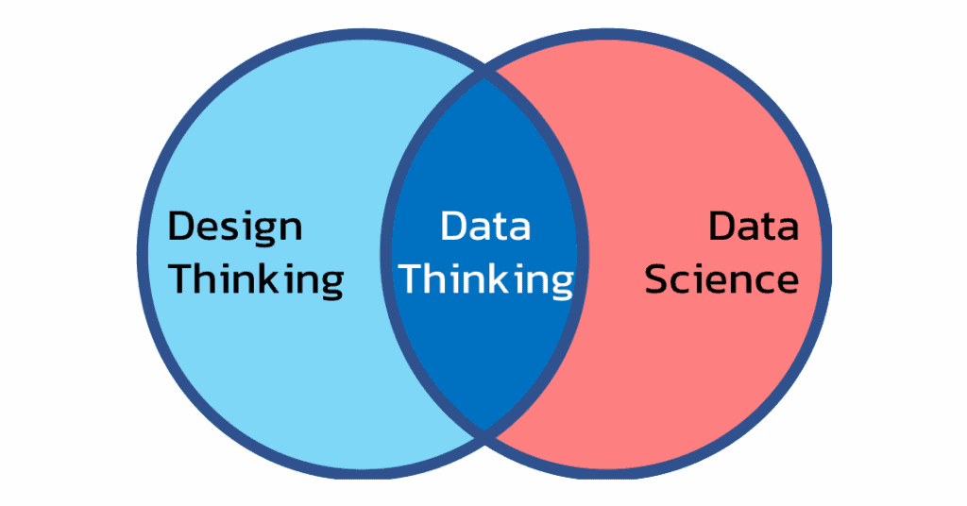
Data Requirements

Slide 8
Data Collection
Data was collected from public source, it is structured dataset .
The challenges were much, as we experienced unlogic inputs in many columns like :
Bathrooms : some rows include 9 bathrooms for a apartment
Area : there was an apartment with 20cm2
Price : there was missing values
Challenges have been solved by :
Do market research to build our data on solid base.
Remove the outliers.
Handled missing values.

Slide 9
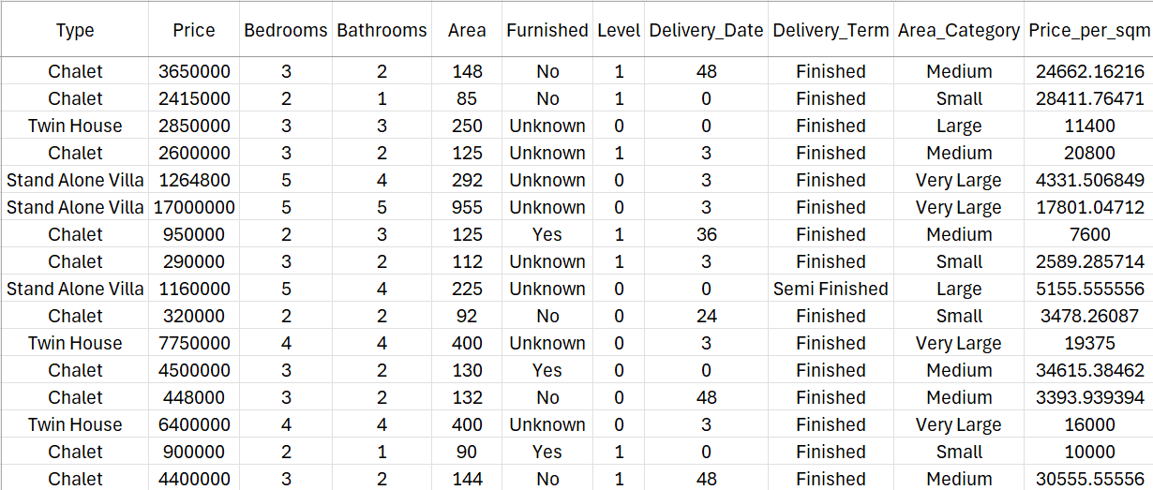
Data Understanding
Dataset Overview :
- Dataset shows information about real state section in Egypt.
- It also shows the variety in price in terms of types, compounds , and cities.

Slide 10
Data Quality :
Irrelevant columns: Presence of non-informative fields such as agent information, internal IDs, and web links.
Missing data:
- Some records had missing values for the target variable (price).
- Several features had more than 30% missing values.
Inconsistent categorical labels:
- Variation in casing (e.g., "Cairo" vs "cairo").
- Mixture of Arabic and English entries.
Outliers:
- Some properties listed with extreme prices (less than 100,000 EGP or more than 50,000,000 EGP).
- Some properties had unrealistic area sizes (less than 20 sqm or more than 1000 sqm)
Source : public data set property listing
Volume : 21,000 record

Slide 11
Data Cleaning process :
Process | Description
- Empty rows | - Removed useless rows
- Handle missing data | - Removed rows with missing target variable ( price ). - Impute missing values with median
- Fix categorical labels | - Standardized text casing (title case).
- Create new features | - Created delivery_time_in_months by calculating months between current date and delivery date.
- Outlier filtering | - Using domain knowledge, we handel outliers separately per property type and feature (Price, Bedrooms, Bathrooms, Area)

Slide 12
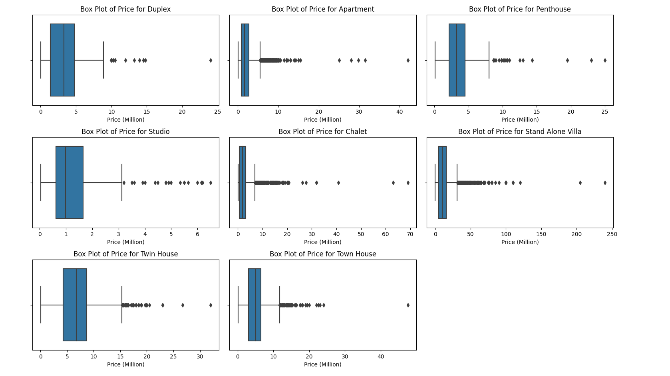
Box plot of price per type

Slide 13
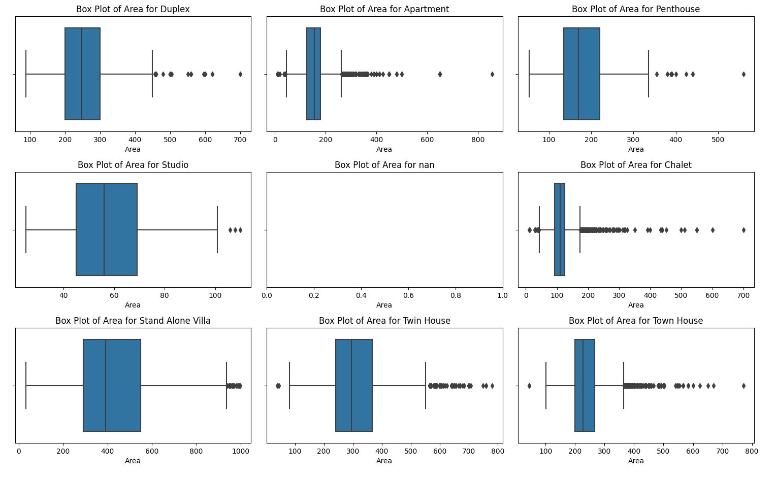
Box plot of area per type

Slide 14
21,000
175
539
Total property
Count of cities
Size of data
Count of compounds

Slide 15
Data Preparation
This script performs comprehensive data cleaning and preprocessing on a real estate dataset. The key steps , include handling duplicates, standardizing categories, converting data types, handling missing values, detecting , and removing outliers.
Handling Duplicates:
- The dataset is copied to avoid modifying the original data.
- Duplicate rows are removed using drop_duplicates().
Standardizing Property Types:
- The Type column contains variations in capitalization for the same property type
(e.g.,"twin house"and "Twin House").
- The values are standardized to maintain consistency.
Cleaning the "Price" Column:
- The script identifies non-numeric values in the Price column, such as "Unknown".
- Rows with "Unknown" prices are removed.
- The Price column is converted to a numeric format.

Slide 16
Cleaning the "Bedrooms" Column:
- A unique value check reveals an entry "10+".
- The value "10+" is replaced with 10.
- The column is converted to a numeric type.
Cleaning the "Bathrooms" Column:
- A unique value check reveals an entry "10+".
- The value "10+" is replaced with 10.
- The column is converted to a numeric type.
Enforcing Logical Ranges for Bedrooms & Bathrooms
- Each property type is assigned a valid range for bedrooms and bathrooms.
- Values slightly outside the range (within 10%) are adjusted.
- Extreme outliers are dropped from the dataset.

Slide 17
Cleaning the "Area" Column
- The script ensures that all values in the Area column are numeric.
- The column is converted to float.
Enforcing Logical Ranges for Area
- Each property type is assigned a valid area range.
- Values slightly outside the range (within 10%) are adjusted.
- Extreme outliers are dropped.

Slide 18
02
Dashboards

Slide 19
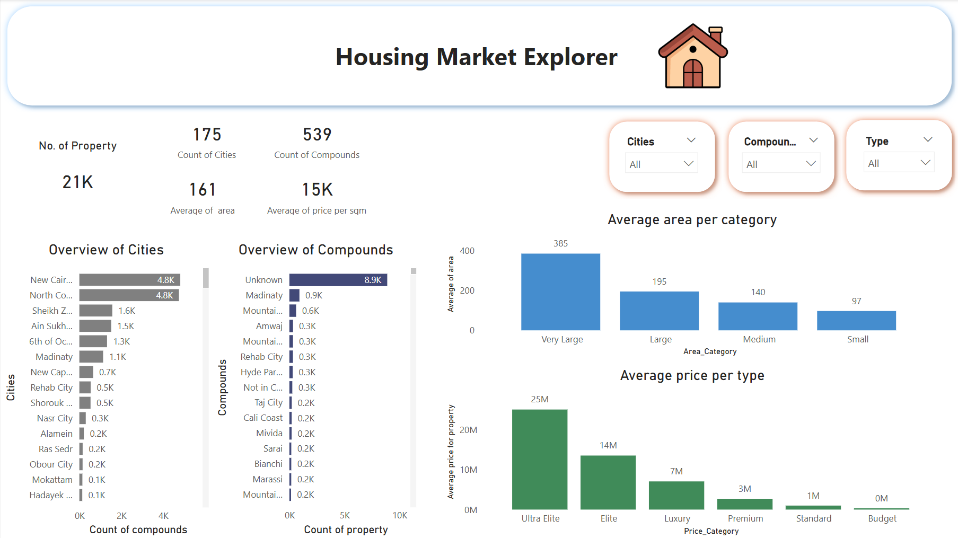

Slide 20
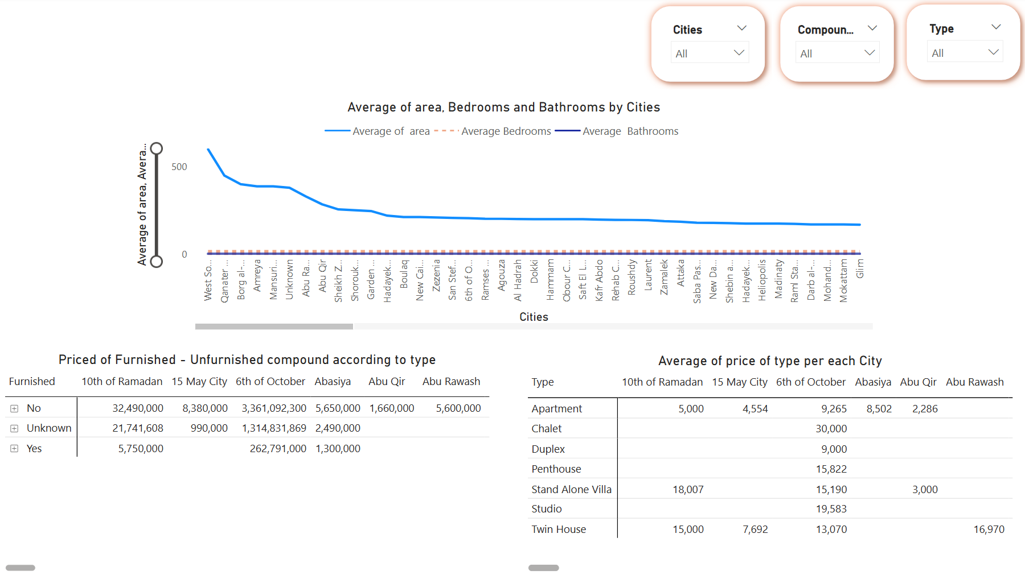

Slide 21
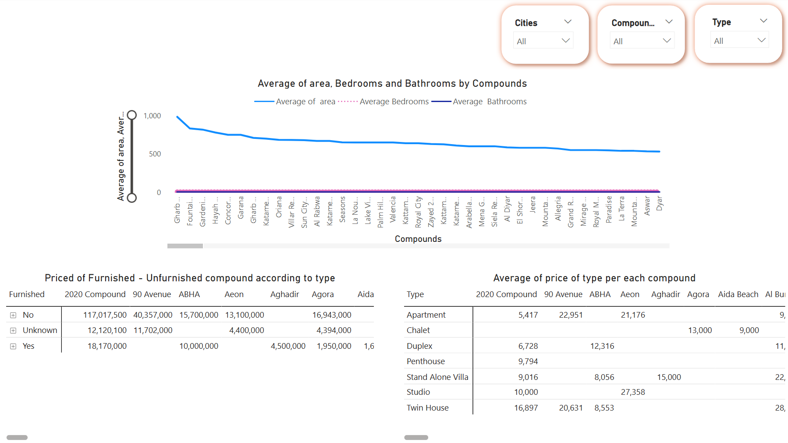

Slide 22
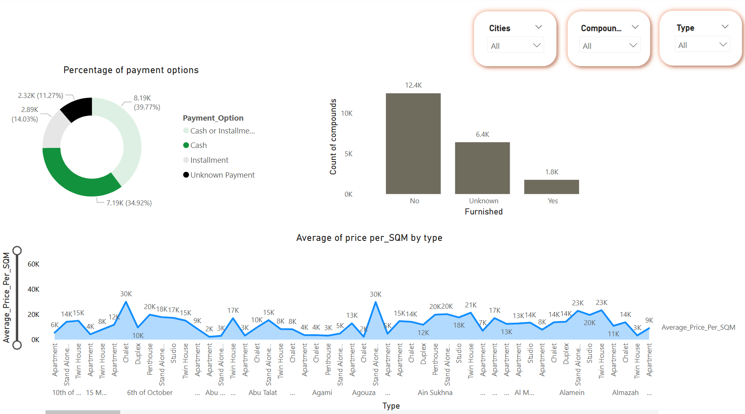

Slide 23
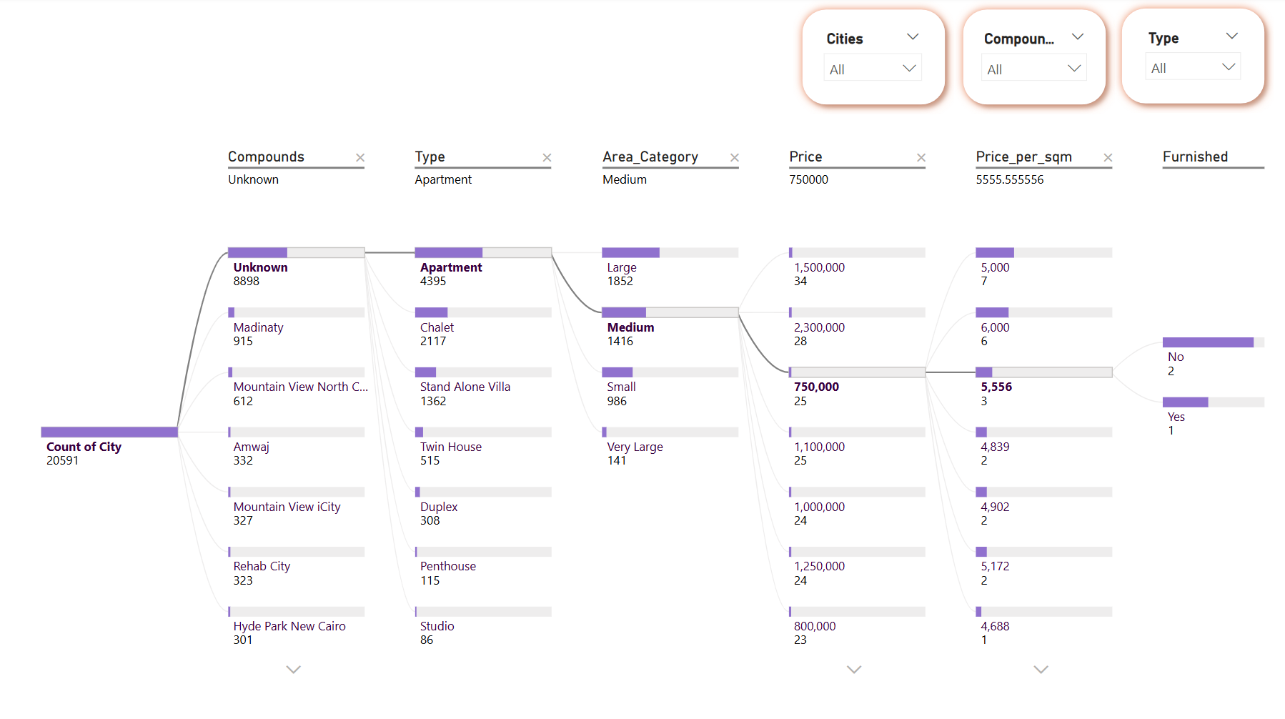

Slide 24
Modeling
Models have been selected are :
- Random Forest
- Support Vector Regression
- XGBoost
- LightGBM
- Neural Network
- Stacked Models
Model Training:
- Data Preprocessing: The data was split into training and test sets using an 80% training and 20% testing split, ensuring proper time-series validation. Features were preprocessed using pipelines that included scaling (Standardization), imputation, and encoding.
- Training: Each model was trained using the training set, followed by hyperparameter tuning through GridSearchCV. The models were evaluated on the training and test sets using the following error metrics:
- RMSE (Root Mean Squared Error)
- R2 (R-squared)

Slide 25
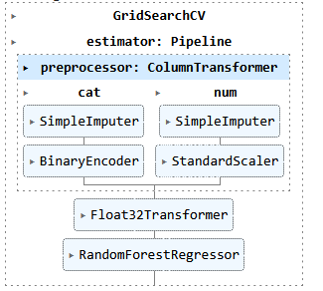
PIPLINE OF THE TRAIN

Slide 26
Model Comparison Table
Best Model: LightGBM performed best, chosen for its small model size and high accuracy.
Model | RMSE | R2 Score
- Random Forest | 0.70 | 0.65
- Support vector Regression | 0.83 | 0.50
- XGBoost | 0.70 | 0.65
- LightGBM (LGBM) | 0.70 | 0.65
- Neural Network | 0.74 | 0.61
- Stacking Models | 0.70 | 0.65

Slide 27
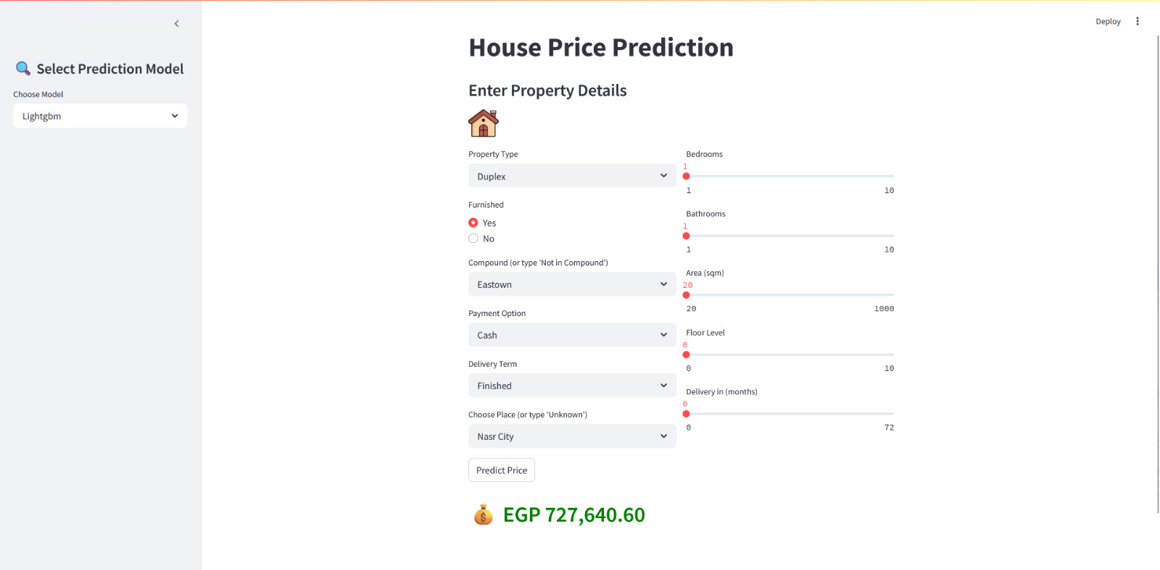
Deployment

Slide 28
Q&A

Slide 29


